Slide 1
Eraser Drawing Machine
a presentation by Ellie Williams

Slide 2
Inspiration
Give the user semblance of artistic control
Take away the user’s outcome control
Forces abstraction
Wanted randomness to be the main foundation
True human-machine collaboration
20XX

Slide 3
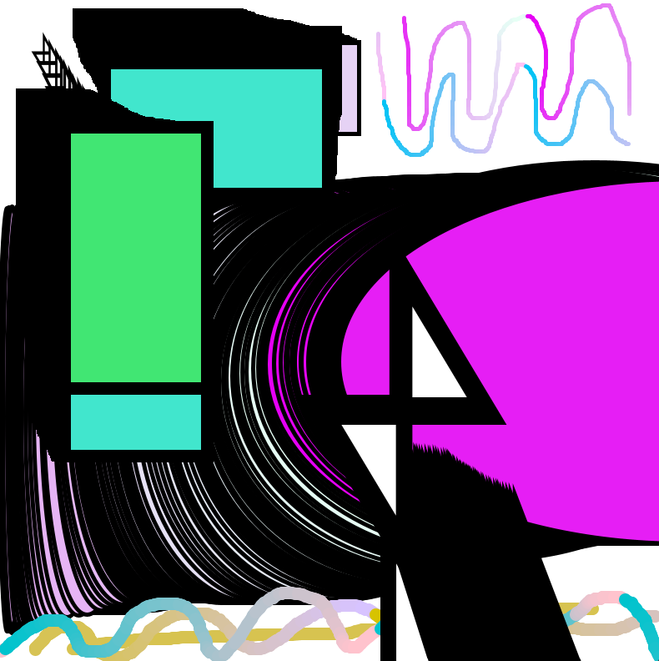
The Start
Free draw for user
  Multiple options for color, thickness, shapes, etc.
Computer alters the drawing
  A character randomly spawns and erases randomly for a short period of time
20XX

Slide 4

Intent of the system
Infinite and endless possibilities
Users can draw forever if they wish without ever repeating the same design.
Notes:
Can draw forever if they wish without every repeating the same design

Slide 5

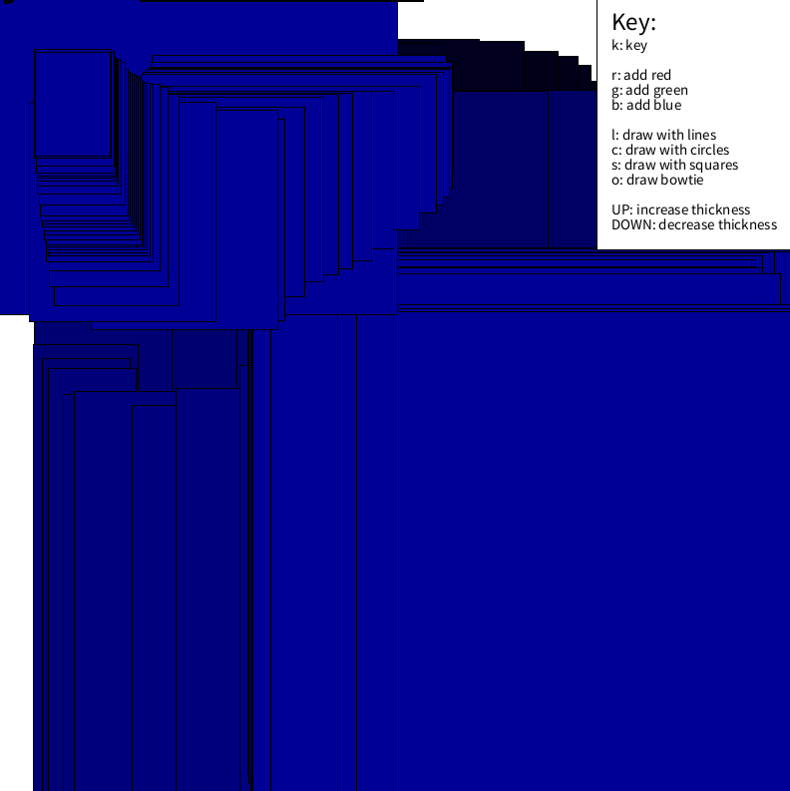

Slide 6
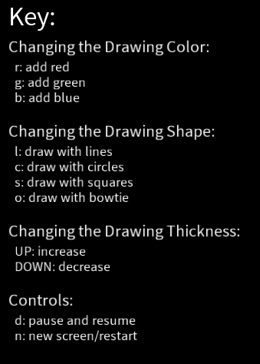
The End
Free draw for user
  Full control over added colors, shapes drawn, chosen thickness, and when to finish
Computer alters the drawing
  Random Features:
    Shape
    Size
    Direction
    Duration
20XX

Slide 7

Video Demonstration
Features shown:
Line Tool
Gradient of Color
Changing Thickness
Changing Shape
Square Tool
Changing Stoke Thickness
Circle Tool
Unique Shape (bowtie) Tool
Pause
Restart Screen
20XX

Slide 8
Issues/Redesign
Making the eraser continuous, not a surprise random generation
  No longer a character
Allowing simultaneous movement
  Not the user pausing to watch the alterations occur
  instead drawing alongside it
20XX

Slide 9
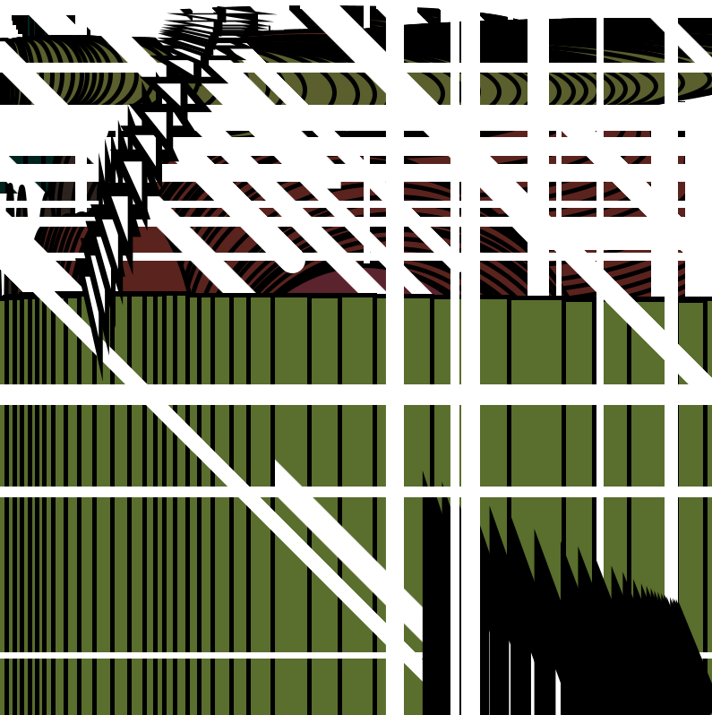
1
20XX

Slide 10

2
20XX

Slide 11

3
20XX

Slide 12
Improvements
Adding breaks in between the erasing, slowing it down
Adding a title slide/ intro that fades with a successful delay
Make the eraser move in shapes:
  Swirls
  Circles
  Chevron pattern
presentation title
20XX

